Slide 1
Hotel Review Parsing: Pre and Post Pandemic
Data Science Masters Capstone
DATS 6501
Mariko McDougall

Slide 2

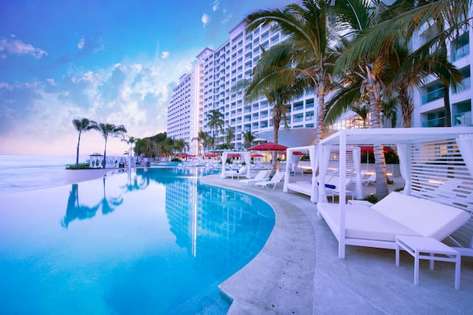
Index
Introduction
Problem Statement
Dataset
Data Statistics
Feature Extraction
Transformer Models
Continuing Work
Literature Review

Slide 3
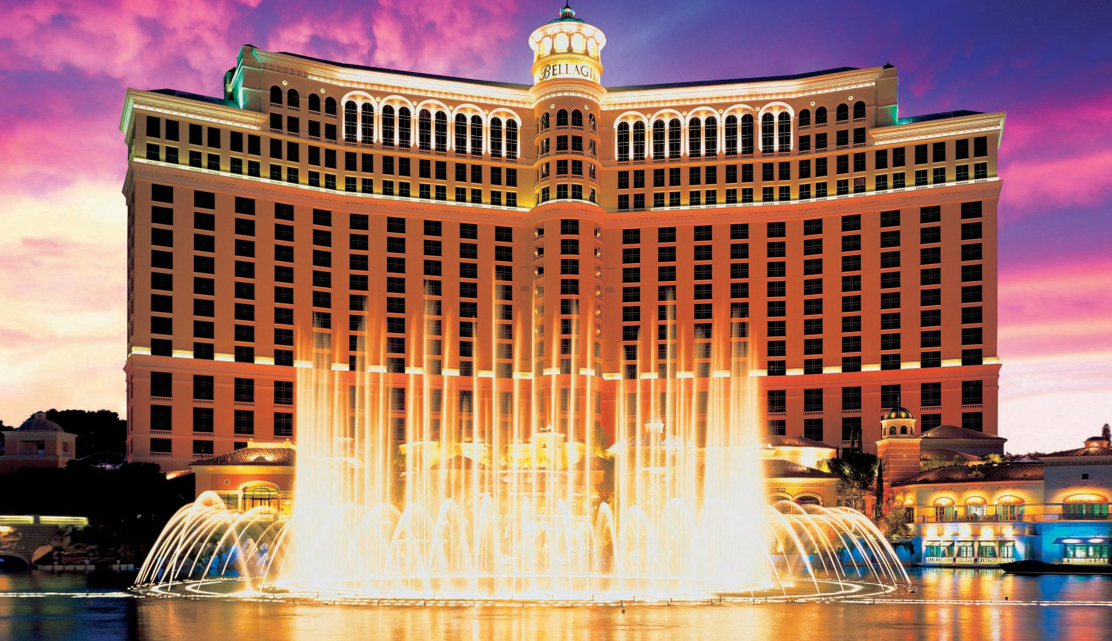
Introduction
The hotel industry, worth over 240 billion dollars globally*, was highly impacted by the Covid-19 pandemic.
Due to both health concerns and travel restrictions, occupancy declined more than 11%, and 4.4% of hotels permanently closed in 2020**.
*Strategic Report - Industry Overview 2020. IHG Hotels and Resorts - Annual reports. (2020).
**Q3 2021 US Hotel Figures. CBREUS Insights and Research. (2021).

Slide 4
Problem Statement
Given the hotel industry’s intense competition for limited customers, knowing what factors have the highest impact on a visitor’s experience is critical to maintaining high review scores, satisfaction and occupancy.
Discerning critical factors may be particularly important now, as customer expectations and requirements may have shifted during the pandemic. For example, sanitation practices are now on the forefront of customers’ minds, where previously they may have had less of an impact on reviews.
Factors will be compared from reviews written both before and during the pandemic, to discern if priorities have changed.

Slide 5
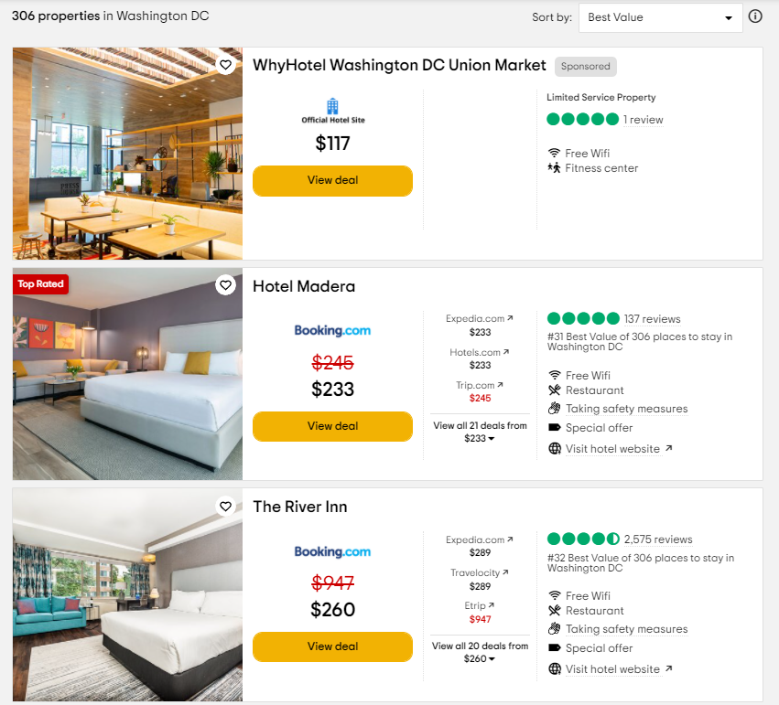
Dataset - Cities
For each State, download reviews for the most populous city
Exception: Connecticut – New Haven instead of Bridgeport
For each City, capture the number of properties, and loop through all pages of listings.
Hotel Listing
Collect link to hotel page if there are more than 50 reviews for the property
This saves time, especially as many small properties do not have any reviews.
Page Sorting
The default sorting system weights for number of reviews, as well as star rating and cost
Once more than half of the page has less than 50 reviews, stop scraping for hotel links.

Slide 6

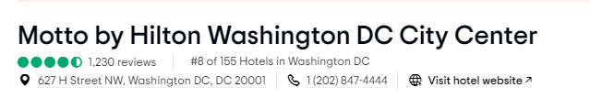
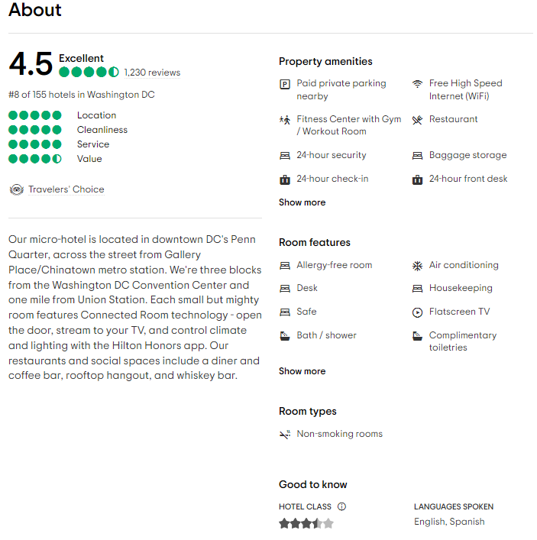
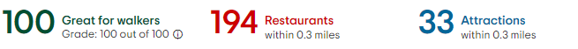
Dataset - Hotel
Hotel ID
Unique ID code combining the city and hotel ID
Hotel Basic Information Section
Hotel name
Number of reviews
Hotel address
About Section
Hotel blurb
Property amenities and Room features
Hotel star rating
Location Section
Walkability score
Restaurants within distance
Attractions within distance

Slide 7
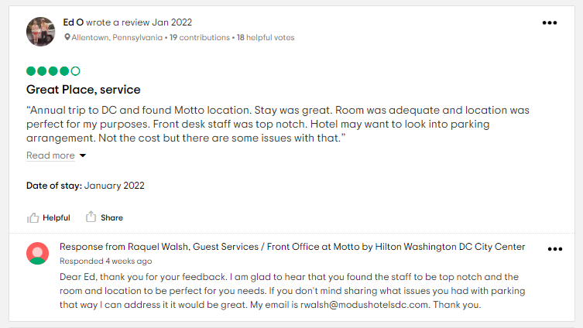
Dataset - Review
Hotel ID
Review Information
Star rating
Title
Text of the actual review
Date of the stay
Reviewer Information
Date review written
Reviewer home location
Maximum of 4000 reviews per hotel
Necessary, as many large hotels have 30,000+ reviews, and reviews are displayed in increments of 5.
For most highly reviewed hotels, this puts us into reviews from 2017.

Slide 8
Data Preprocessing
Hotel Database
Reviews Database
Parse state from the hotel address
Some hotels served major cities, but were not technically within the city boundaries
eg, Paradise, NV and Las Vegas, NV
Calculate attraction density
The radius distance on Tripadvisor varies based on the number of attractions
Text Processing
Title and review body combined
Tokenizing
Removing stop words
Lemmatizing
Removing punctuation, isolated numbers, etc
Date Processing
Dates parsed into datetime
Binary columns:
Review Written Pre/During Pandemic
Visit Pre/During Pandemic

Slide 9
Data Statistics - Overall
Statistic | Overall | Pre-Pandemic | Pandemic
Total Number of Hotels | 3,922 | - | -
Total Number of Reviews | 3,774,238 | 3,442,834 | 331,404
Mean Review Rating | 4.07 | 4.10 | 3.81
STD of Review Ratings | 1.19 | 1.16 | 1.50

Slide 10
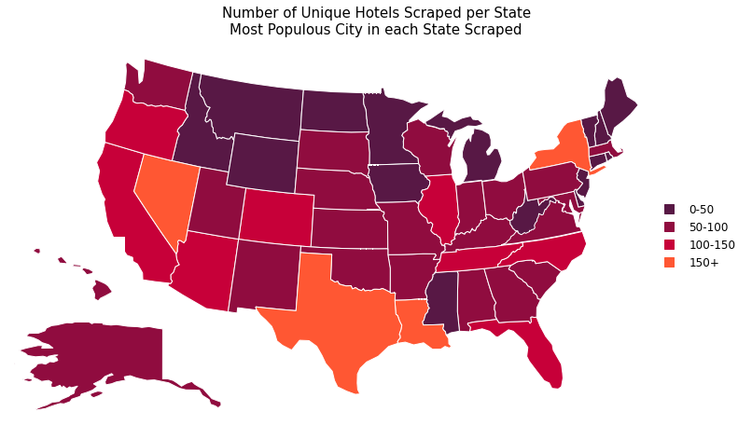
Data Visualizations – Hotels by State
Notes:
Min value: RI with 16 hotels, max Texas with 218

Slide 11
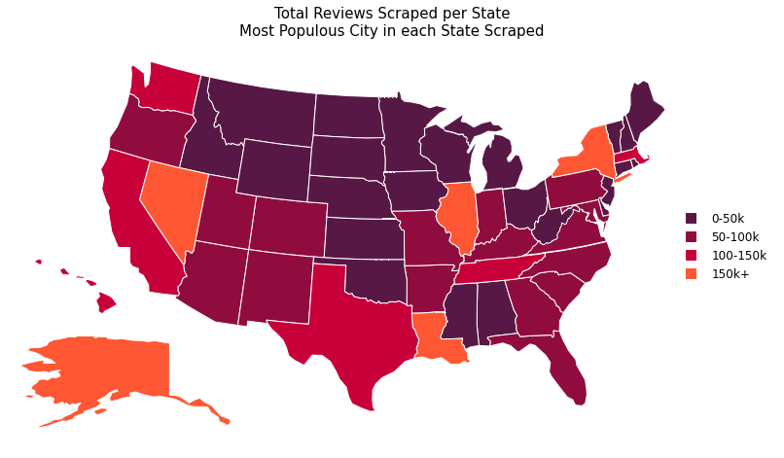
Data Visualizations – Reviews by State
Notes:
Min value: Missisipi with 8310 reviews, max Nevada with 299,316

Slide 12
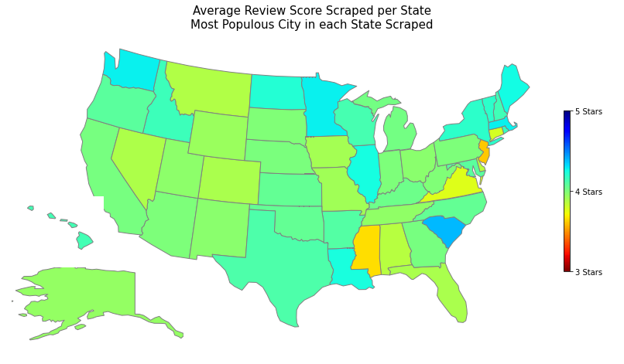
Data Visualizations – Average Review by State

Slide 13
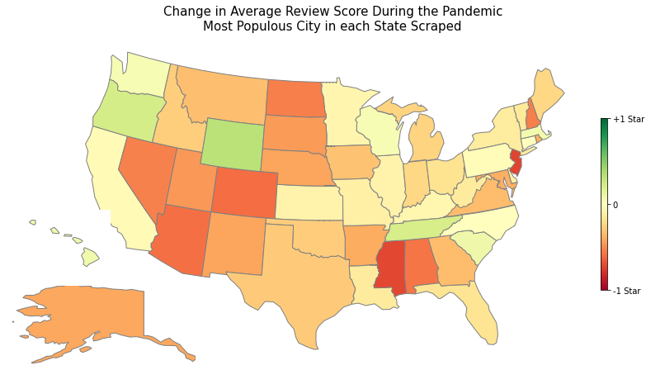
Data Visualizations – Change in Reviews

Slide 14
Feature Extraction
TfidfVectorizer
CountVectorizer
Converts the cleaned tokens into a sparse matrix of token counts
Extract unigrams and bigrams
Individual words, and the individual word +1, captures relationships.
Maximum 10000 features
Ensures that uncommon words (typos, proper names) are not represented
TfidfTransformer
Converts the sparse matrix from CountVectoriser into tf-idf
Tf-idf : Term-frequency * Inverse Document Frequency
Scales down the impact of frequent tokens

Slide 15
Feature Extraction - Categorization
Full Dataset
Includes all reviews, irrespective of location, star rating, and date
Quality of Stay
Good – Review rating of 4 stars or greater
Bad – Review rating of 2 stars or less
Pandemic
Pre-Pandemic – Before February 1st 2020
Pandemic – After and including February 1st 2020

Slide 16
Feature Extraction
Ranking | Full Dataset | Good | Bad | Pre-Pandemic | Pandemic
0 | hotel | hotel | room | hotel | room
1 | room | room | hotel | room | hotel
2 | great | great | stay | great | great
3 | stay | stay | night | stay | stay
4 | staff | staff | would | staff | staff
5 | nice | nice | one | nice | clean
6 | location | location | staff | location | nice
7 | good | clean | desk | good | service
8 | clean | good | bed | clean | location
9 | breakfast | breakfast | service | breakfast | time
10 | service | friendly | front | service | good

Slide 17
Feature Extraction
Ranking | Full Dataset | Good | Bad | Pre-Pandemic | Pandemic
0 | hotel | hotel | room | hotel | room
1 | room | room | hotel | room | hotel
2 | great | great | stay | great | great
3 | stay | stay | night | stay | stay
4 | staff | staff | would | staff | staff
5 | nice | nice | one | nice | clean
6 | location | location | staff | location | nice
7 | good | clean | desk | good | service
8 | clean | good | bed | clean | location
9 | breakfast | breakfast | service | breakfast | time
10 | service | friendly | front | service | good
Clean = 28
Notes:
Note: for Bad, Dirty is #19.

Slide 18
Feature Extraction
Ranking | Full Dataset | Good | Bad | Pre-Pandemic | Pandemic
0 | hotel | hotel | room | hotel | room
1 | room | room | hotel | room | hotel
2 | great | great | stay | great | great
3 | stay | stay | night | stay | stay
4 | staff | staff | would | staff | staff
5 | nice | nice | one | nice | clean
6 | location | location | staff | location | nice
7 | good | clean | desk | good | service
8 | clean | good | bed | clean | location
9 | breakfast | breakfast | service | breakfast | time
10 | service | friendly | front | service | good
Breakfast = 22
Breakfast = 14

Slide 19

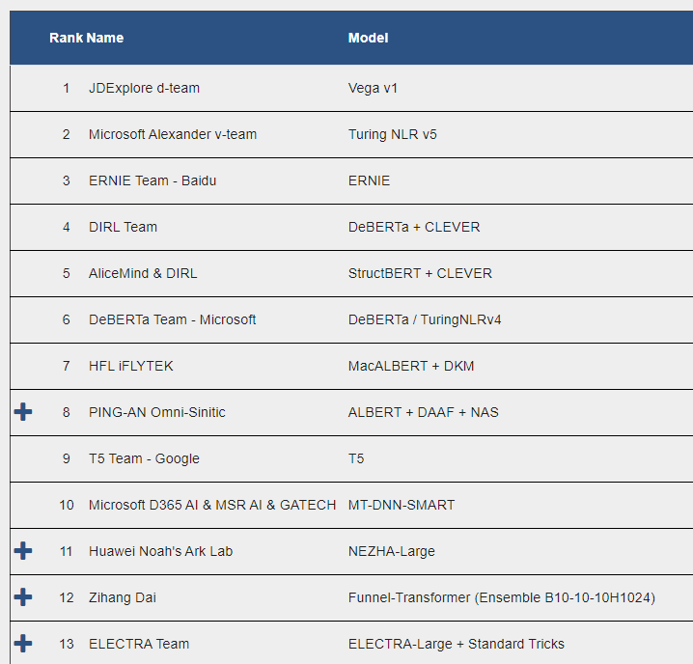
Transformer Models
ELECTRA
Very lightweight model
Uses replaced token detection, similar to a GAN network, rather than missing tokens
Performance exceeds human baselines (rank 21)
ERNIE
3rd ranked on the leaderboard
Much larger model than Electra
Available as a transformer model
Vega
Current GLUE leader
Not available in the HuggingFace transformers library
No paper currently published
…

Slide 20
Transformer Models
ELECTRA
Very lightweight model
Uses replaced token detection, similar to a GAN network, rather than missing tokens
Performance exceeds human baselines (rank 21)
ERNIE
3rd ranked on the leaderboard
Much larger model than Electra
Available as a transformer model
Vega
Current GLUE leader
Not available in the HuggingFace transformers library
No paper currently published
…

Slide 21
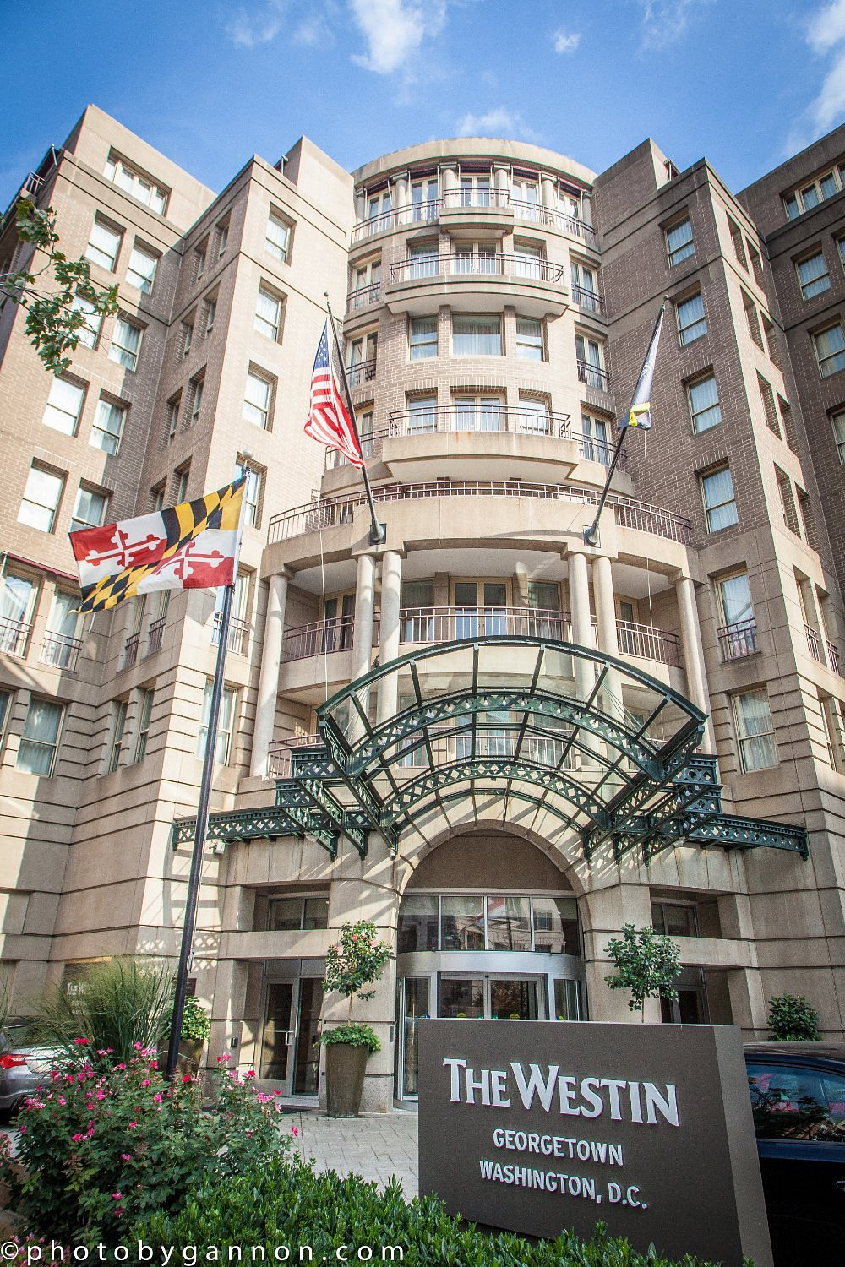
Continuing Work
Training the transformer model
Extracting feature influence measurements from the transformer
Overall
By Pandemic Timing
By Sentiment
By State
By Region
Create a website to display findings

Slide 22
Literature Review
Bird, S., Klein, E., & Loper, E. (2009). Natural Language Processing with Python: Analyzing Text with the Natural Language Toolkit. O'Reilly Media, Inc.
Clark, K., Luong, M. T., Le, Q. V., & Manning, C. D. (2020). Electra: Pre-training text encoders as discriminators rather than generators. arXiv preprint arXiv:2003.10555.
Guo, S.; Wang, Q. Application of Knowledge Distillation Based on Transfer Learning of ERNIE Model in Intelligent Dialogue Intention Recognition. Sensors 2022, 22, 1270. https://doi.org/10.3390/s22031270
Vivek, S. (2018, December 17). Automated keyword extraction from articles using NLP. Medium. Retrieved February 10, 2022, from https://medium.com/analytics-vidhya/automated-keyword-extraction-from-articles-using-nlp-bfd864f41b34
Strategic Report - Industry Overview 2020. IHG Hotels and Resorts - Annual reports. (2020). Retrieved January 20, 2022, from https://www.ihgplc.com/-/media/FBBD6EBDD4D14EAD88A08E62F7911E74.ashx
Q3 2021 US Hotel Figures. CBREUS Insights and Research. (2021). Retrieved January 21, 2022, from Q3 2021 US Hotel Figures

Slide 23
Thank you for Listening
Any Questions?

Slide 24
Supplemental Slides

Slide 25
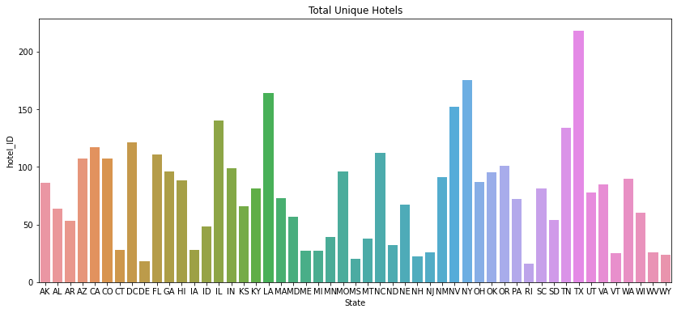
Total Unique Hotels by State

Slide 26
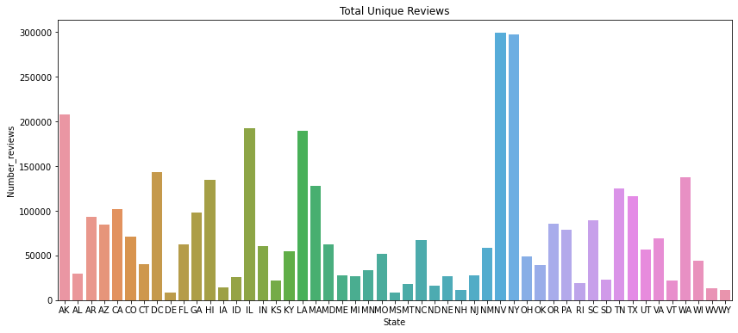
Total Unique Reviews by State

Slide 27
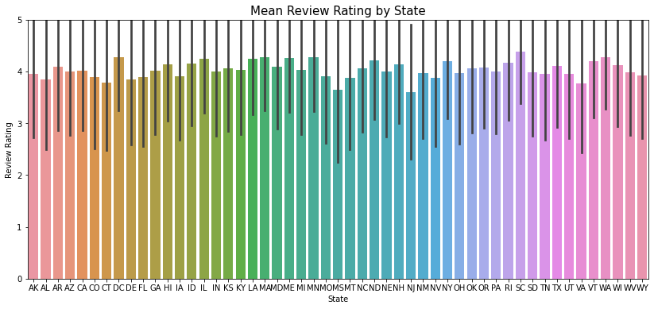
Mean Review by State with STD

Slide 28
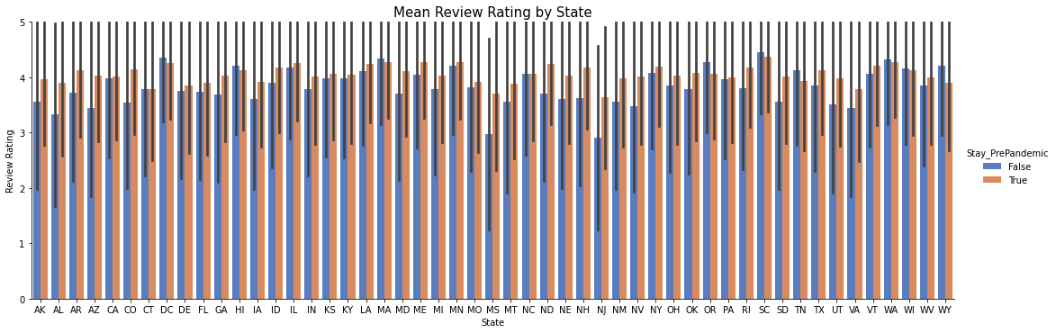
Change in Reviews by State – Pre and during Pandemic

